Slide 1
Introduction to Groundwater Modeling
Peter Leffler
Principal Hydrogeologist
Luhdorff & Scalmanini, Consulting Engineers
East Bay Plain Subbasin – Groundwater Sustainability Plan
Technical Advisory Committee Meeting
October 2, 2019

Slide 2
Topic of Discussion
Why Use a Groundwater Model?
What is a Hydrogeologic Conceptual Model?
Groundwater Model Development
Groundwater Modeling Platform Selection
Groundwater Model Maintenance
Key Takeaways
Any Questions?

Slide 3
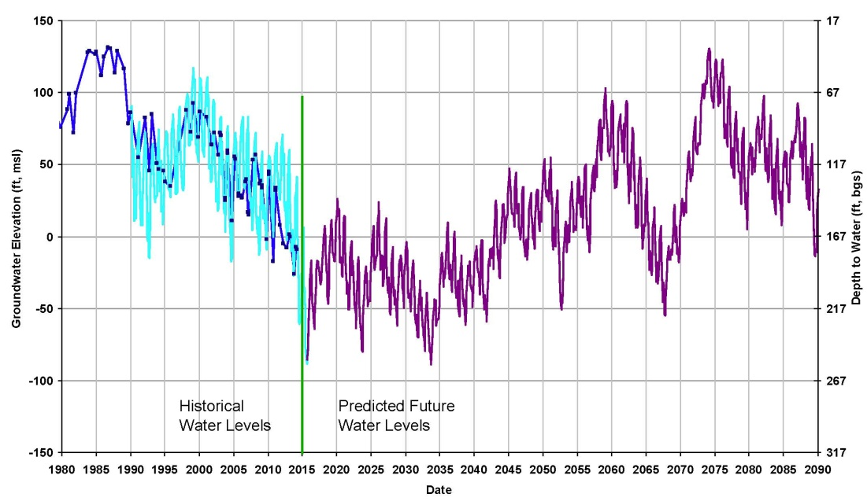
1. Why Use a Groundwater Model?
To integrate many different types of data (e.g., aquifer parameters, water budget components, water levels)
To study aquifer response to changes in GW system stresses (GW level fluctuations, GW flow directions/rates, GW storage change)
To predict future changes in GW levels and fluxes from various management actions and changes in hydrologic regime (e.g., climate change)
To be used as a tool in decision making

Slide 4
1. How can a groundwater model be used in a GSP?
To develop a better understanding of historical, current, and future groundwater system dynamics (e.g., cones of depression, DTW, overdraft, GW–SW interaction)
To evaluate sustainable management criteria (MTs and MOs)
To evaluate effects of projects and management actions (prediction of future changes in GW levels)
To evaluate sustainable yield of the subbasin

Slide 5
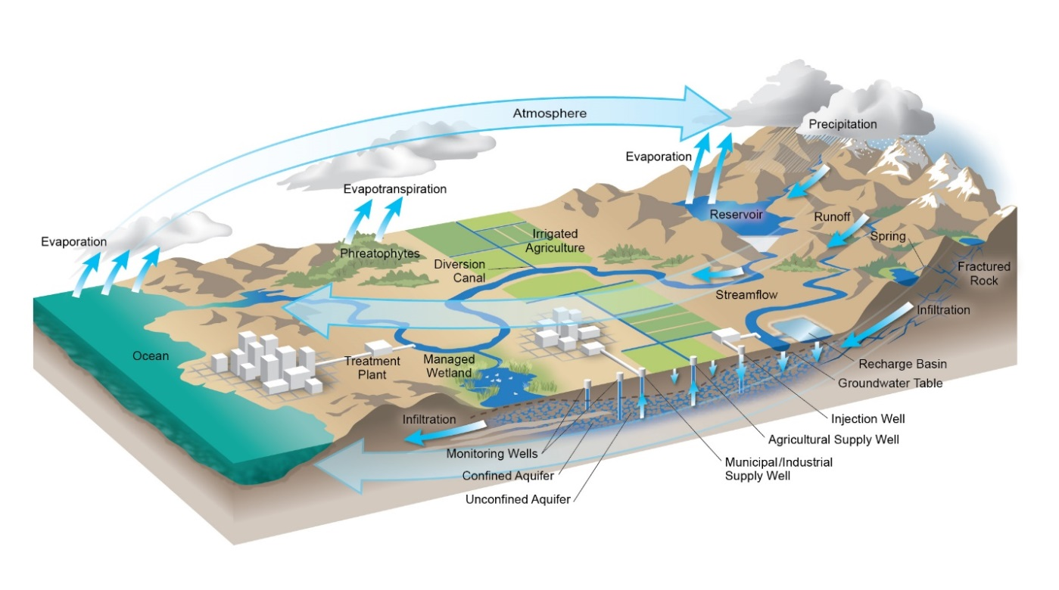
2. Hydrogeologic Conceptual Model
A written and graphic depiction of the aquifer system, occurrence of groundwater, groundwater levels and flow, and water budget

Slide 6
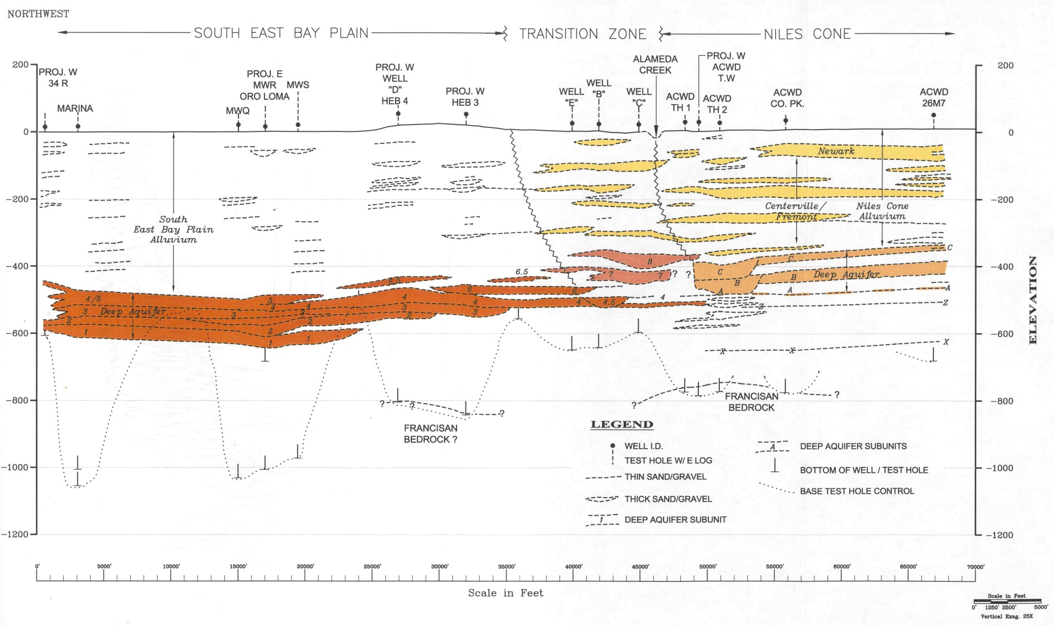
2. Hydrogeologic Conceptual Model (HCM)
Characterize aquifer system based on available data and information

Slide 7
2. Hydrogeologic Conceptual Model
Characterize Water Budget

Slide 8
2. Hydrogeologic Conceptual Model

Slide 9
2. Hydrogeologic Conceptual Model
Field Sample Collection
Sand and Gravel
Clay

Slide 10
2. Hydrogeologic Conceptual Model
Geophysical Logging

Slide 11
2. Hydrogeologic Conceptual Model
GW flow directions and velocity based upon GW levels (known as heads)
GW flow is considered in horizontal and vertical components
Pumping wells and pumping rates influence GW flow rates and flow directions
GW levels are used to construct GW contour maps (lines of equal elevation)

Slide 12
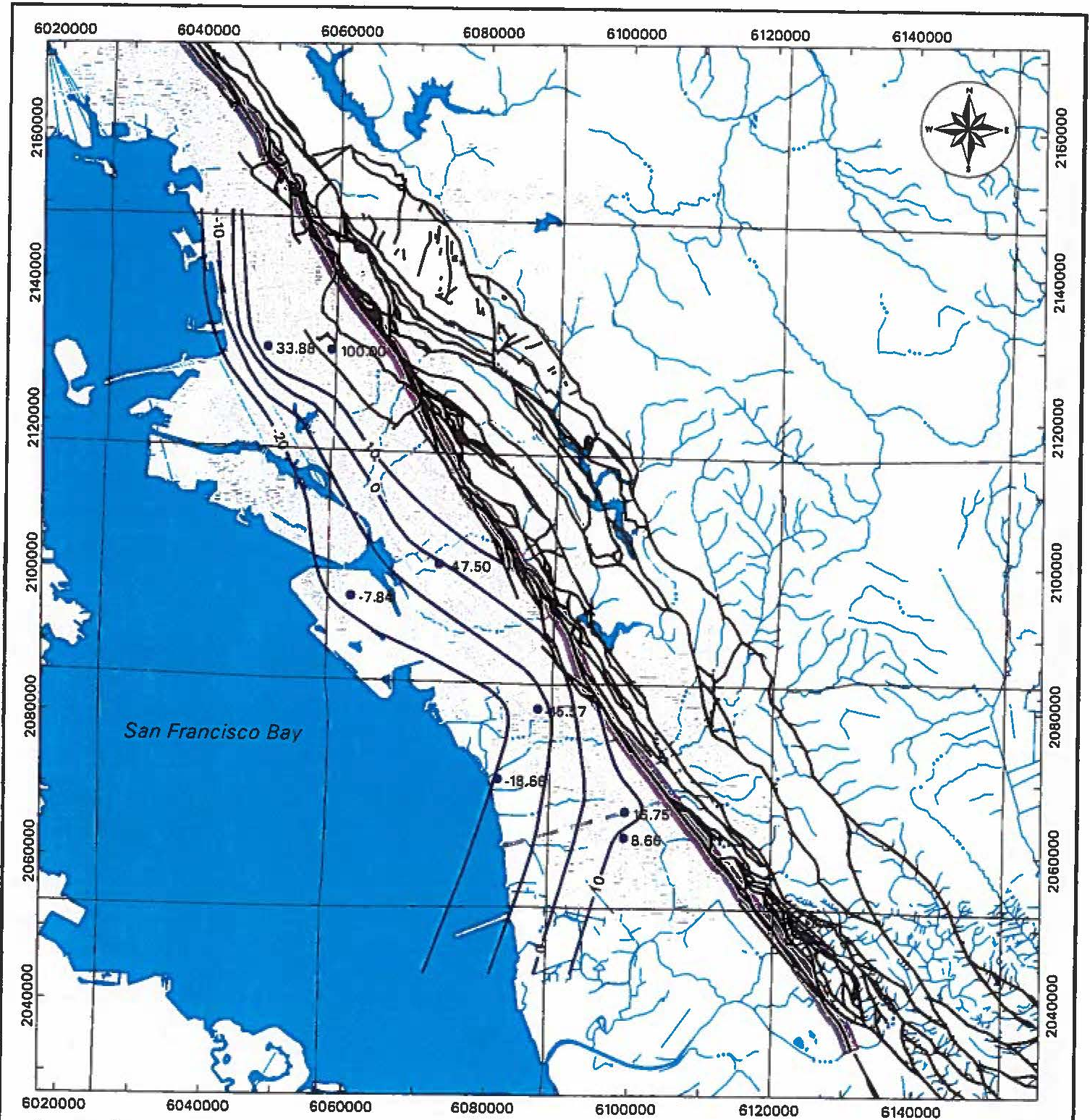
2. Hydrogeologic Conceptual Model
Characterize Groundwater Levels and Flow

Slide 13
2. Hydrogeologic Conceptual Model
Darcy’s Law Q = KiA; where
Q = volumetric rate of groundwater flow (L³/T)
K = hydraulic conductivity (L/T)
i = hydraulic gradient (dimensionless)
A = cross-sectional area of flow (L²)
q = Ki/n; where
q = velocity of groundwater flow (L/T)
i = hydraulic gradient (dimensionless)
n = porosity (dimensionless) – should use effective porosity, but only significant for fine-grained materials

Slide 14
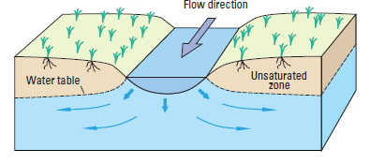
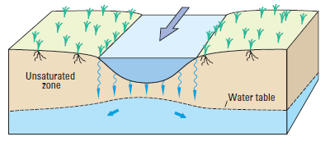
2. Hydrogeologic Conceptual Model
Groundwater – Surface Water Interaction
Gaining Stream - GW recharges stream
Losing Stream - Stream recharges GW
Disconnected Stream - Infiltration rate constant, recharge amount dependent on stream level, streambed/bank geometry, streambed K
USGS Circular 1376, Barlow and Leake (2012). Figure modified from Winter and others (1998).

Slide 15
2. Hydrogeologic Conceptual Model
Aquifer Parameters
Hydraulic conductivity (K) defined as the rate of flow of water through a unit cross-section under a unit hydraulic gradient
Transmissivity (T) defined as K times saturated thickness
Specific yield (Sy) defined as ratio of volume of water drained by gravity from saturated material to total aquifer volume (0.01 to 0.3)
Storage coefficient (S) defined as ratio of volume of water derived from aquifer skeleton compression and water expansion to total aquifer volume (0.005 to 0.00005)
T, S, and pumping (amount/duration) are key variables that define lateral/vertical extent of pumping cone of depression
Aquifer parameters most accurately defined by pumping tests
(from Driscoll, 1986)

Slide 16
3. Groundwater Model Development
What is a Groundwater Model
Mathematical Representation of a Groundwater System
Different Types of Models
Flow
Transport
Simplified Representation of Complex Natural Conditions

Slide 17
3. Groundwater Model Development
Model Domain
Define the horizontal and vertical boundaries of the aquifer system to be simulated by the model

Slide 18
3. Groundwater Model Development
Model Grid/Layers
Define spacing of model cells/nodes
Define number and thickness of model layers

Slide 19
3. Groundwater Model Development
Model Inputs
Define zones and values for initial aquifer parameters (e.g., T/K, Sy, Ss)
Define location/magnitude of sources/recharge and sinks/discharge (e.g., precipitation recharge, streamflow infiltration, pumping)

Slide 20
3. Groundwater Model Development
Model Boundary Conditions
Define nature of groundwater flow along boundaries of model domain (e.g., no flow vs. flow across boundary)
Types
No Flow
Specified Flow
Constant Head
General Head
Define water levels, conductance and/or fluxes along margins of model

Slide 21
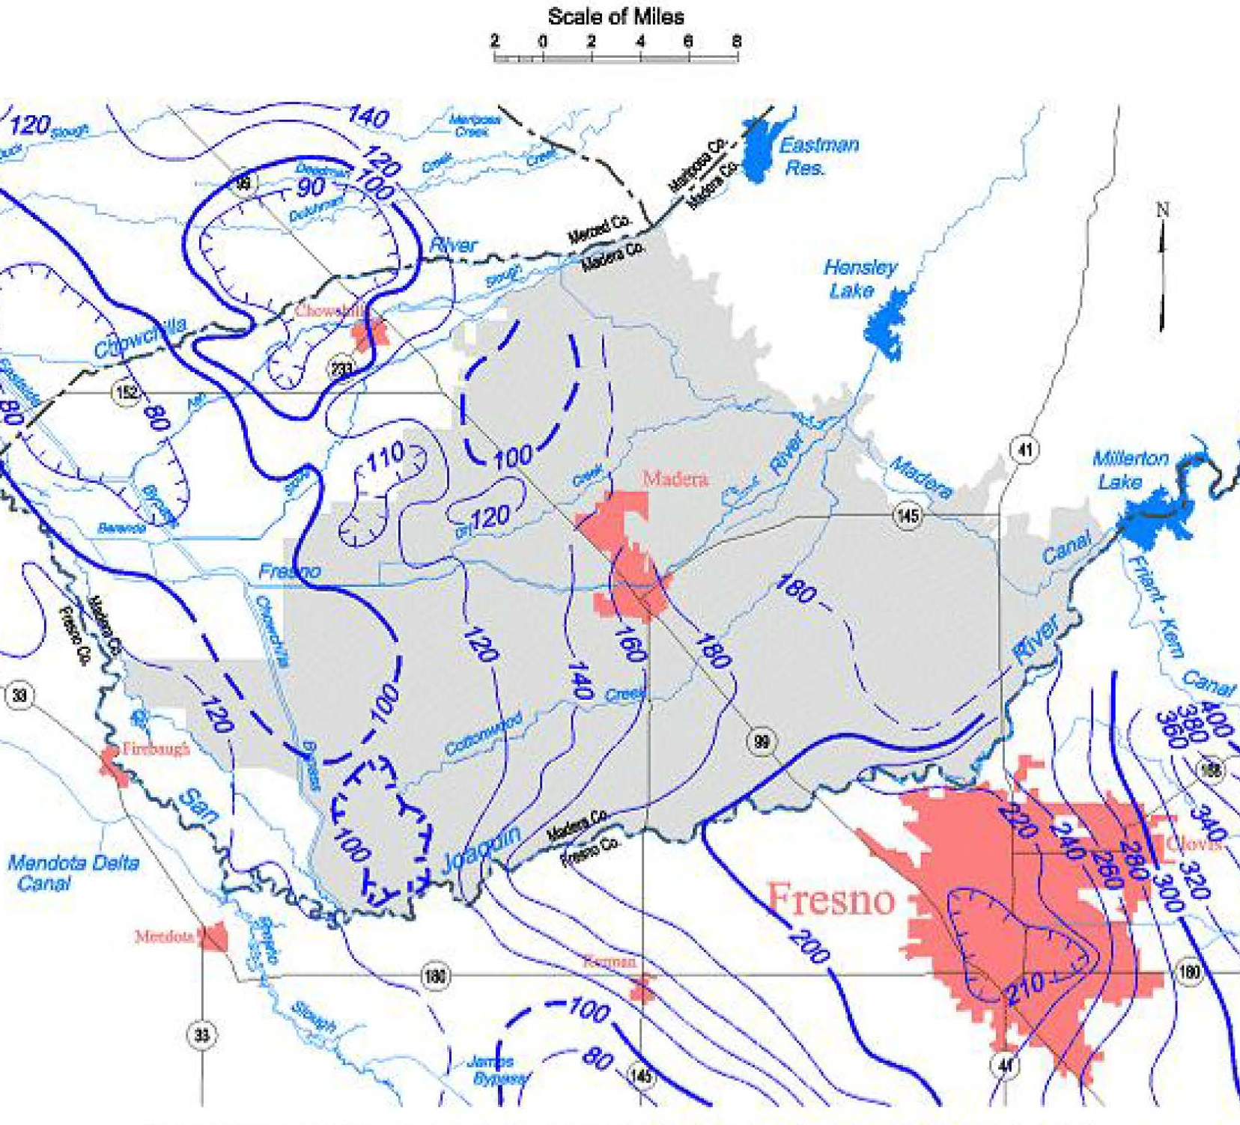
3. Groundwater Model Development
Model Initial Conditions
Define water levels during initial year of model simulation within the model domain
Options include: steady state model run; groundwater contour map(s) for starting year

Slide 22
3. Groundwater Model Development
Model Stress Periods and Time Steps
Define time periods during which model stresses (recharge and discharge components) remain constant (Model Stress Periods)
Define time periods within stress periods for which model calculates results (Model Time Steps)

Slide 23
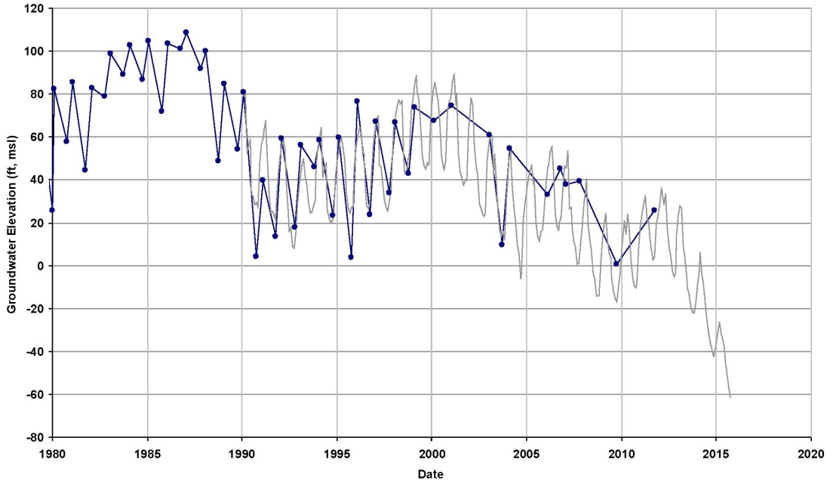
3. Groundwater Model Development
Model Calibration
Conduct Manual and/or Automated Matching of Model Simulated to Observed Water Levels
Adjust Selected Aquifer Parameters and/or Water Budget Components to Improve Match of Model Simulated to Observed Water Levels
Evaluate Goodness of Fit
Conduct Sensitivity Analyses

Slide 24
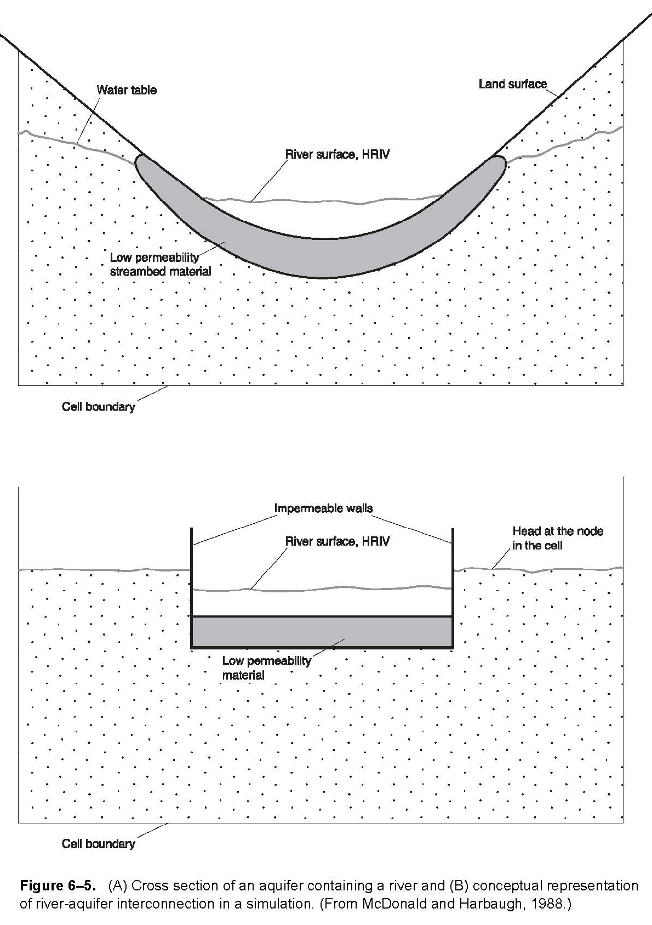
3. Groundwater Model Development
Groundwater Model Limitations
All models are non-unique
Models are simplifications of natural conditions
Quality of model is highly dependent on input data
All models have a degree of uncertainty; multiple inputs/parameters required
Models best used as planning tools to evaluate relative differences of different scenarios/actions

Slide 25
4. Groundwater Modeling Platform Selection
Model Types
Physical (e.g., “Sand Box” Models)
Mathematical (Analytical vs. Numerical)
Numerical Model Code/Platform Options
MODFLOW
IWFM
Others
EBP Subbasin GSP Subtask 4.3 TM Model Objectives and Model Selection

Slide 26
5. Groundwater Model Maintenance
Models are meant to be updated, refined, and recalibrated in the future as additional data are collected and becomes available
Consider periodic model updates
Level of effort for future updates depends on construction (e.g., aquifer parameters) and performance of existing model compared to new data acquired; for example
Does new aquifer test data match existing aquifer parameter inputs reasonably well?
Can existing model provide reasonable simulation of water level fluctuations observed in recent data?

Slide 27
6. Key Takeaways
A good and well developed hydrogeologic conceptual model is the foundation of a good numerical groundwater model
Groundwater models support decision making
The initial groundwater model developed for the GSP will evolve and improve over time as more data is collected

Slide 28
Any Questions?
The Hydrologic Cycle, DWR Water Budget BMP, 2016

