Slide 1
Diversity, Equity, and Inclusion
Strategic Plan Update
Legislative/Human Resources Committee
August 9, 2022
Notes:
1
1
1
1
1
1
1

Slide 2
Agenda
FY 2022 Accomplishments and FY 2023 Implementation
Employee Spotlights
    Leadership Accountability
    Workforce Diversity
    Inclusive Culture
    Supplier Diversity
    Social Responsibility
Next Steps

Slide 3
Fiscal Year 2022 Accomplishments
Key Accomplishments
Formation of Office of Diversity, Equity, and Culture (ODEC)
Implementation of five pilot projects
Application of Equity Lens to policy/procedures review process
Enhanced recruiting partnerships with external community partners
Affinity Group expansion
EEO care services pilot
Career awareness programming
DEISP Action Items
Completed | 6
In Process | 41
Ongoing | 14
Deferred to FY 2023 | 17

Slide 4
Fiscal Year 2023 Implementation
Key Priorities
    Hiring of key positions in ODEC and the HR Department
    Implementation of items deferred to FY 2023
    Increasing internal training for District staff
      DEI education
      Professional development opportunities
    Improving outreach strategies for supplier diversity
FY 2023
    Staff to evaluate project progress and outcomes and develop an updated action plan for FY 2024-25

Slide 5
Strategic Pillar 1:
Leadership Accountability
Employee Spotlight:
Daniel Gill and Clarence Peralta (Superintendents of Water Treatment/Distribution/Quality)
Inspired to have open and authentic conversations with their team after attending an ODEC DEI presentation
Discussed leadership best practices, expectations, and challenges
Explored ways to support the District’s vision of an inclusive work culture

Slide 6
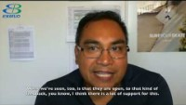
Strategic Pillar 1:
Leadership Accountability

Slide 7
Strategic Pillar 2:
Workforce Diversity
Employee Spotlight:
Gistand Williams (Assistant Construction and Maintenance Superintendent)
Participated in first EBMUD Peralta Cohort Program (2017-19), taking advantage of the mentoring and job shadowing opportunities
Allison Brede (Water Treatment Operator)
Panelist on Changing Career Paths session for “Career Conversations,” where she discussed her nontraditional career pathway

Slide 8
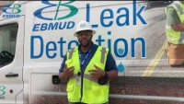
Strategic Pillar 2:
Workforce Diversity

Slide 9
Strategic Pillar 3:
Inclusive Culture
Employee Spotlight:
Laura Johnson (Manager of Pipeline Construction and Equipment)
Panelist on Imposter Phenomenon/Women Leading in the Water Industry session for “Inclusive Leadership Forums,” where she discussed her leadership journey and experiences
Chandra Johannesson (Manager of Environmental Compliance)
Participant in Laura’s “Inclusive Leadership Forum” session

Slide 10
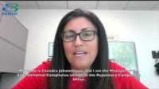
Strategic Pillar 3:
Inclusive Culture

Slide 11
Strategic Pillar 4:
Supplier Diversity
Employee Spotlight:
Beverly Johnson (Contract Equity Administrator)
Offers perspective on the importance of building relationships with small, diverse businesses via virtual business forums
Michael Ambrose (Manager of Maintenance and Construction/Water Operations)
Offers perspective on the importance of the application of contract equity principles throughout the contract management process

Slide 12
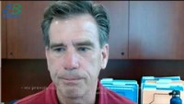
Strategic Pillar 4:
Supplier Diversity

Slide 13
Strategic Pillar 5:
Social Responsibility
Employee Spotlight:
Gary Walters, PTA Lead (Construction/Maintenance
Superintendent)
Nicholas Farrell, PTA Lead (Assistant Construction
and Maintenance Superintendent)
Dion Ridge, (Water Distribution Plumber III)
Pipeline Training Academy (PTA) staff engaged with Kennedy High School students in Richmond, CA

Slide 14
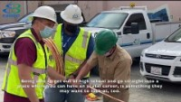
Strategic Pillar 5:
Social Responsibility

Slide 15
Employee Acknowledgements
Michael Ambrose | Beverly Johnson
Allison Brede | Laura Johnson
Courtney Carlson | Clarence Peralta
Asusena Cisneros (Workforce Development Intern) | Sheena Pittman
Steven Currie | Dion Ridge
Rob DeSanti | Brandon Robinson
Elizabeth Dodge (Workforce Development Intern) | Donovan Szarka
Nicholas Farrell | Gary Walters
Dan Gill | Gistand Williams
Tyrell Jackson | Jeremy Williams
Chandra Johannesson

Slide 16
Next Steps
Continue implementation of the DEISP’s action items
Fill remaining vacant positions
Update to the Legislative/Human Resource Committee on September 13, 2022

